Slide 1
Chapter 13
Object-oriented Techniques

Slide 2
Object oriented programming (Booch 1991)
“Object Oriented Programming is a method of implementation in which programs are organised as a co-operative collection of objects, each of which represents an instance of some class, and whose classes are all members of a hierarchy of classes united via inheritance relationships.”

Slide 3
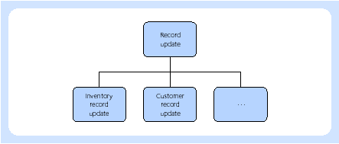
Object orientation
Hierarchy of classes

Slide 4
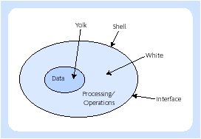
Object orientation
Objects represented by an egg
(modified from Daniels and Cook, 1992)

Slide 5
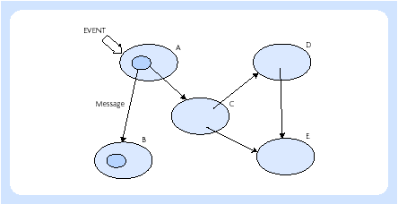
Object orientation
A network of objects make up a program

Slide 6
Unified Modelling Language (UML)
Provide users a ready-to-use, expressive, visual modelling language so they can develop and exchange meaningful models.
Provide extensibility and specialization mechanisms to extend the core concepts.
Be independent of particular programming languages and development processes.
Provide a formal basis for understanding the modelling language.
Encourage the growth of the object-oriented tools market.
Support higher-level development concepts.
Integrate best practices and methodologies.

Slide 7
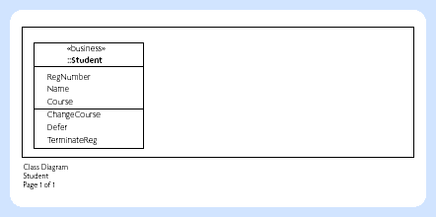
Class diagram

Slide 8
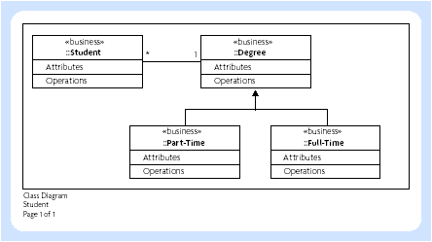
Class diagram

Slide 9
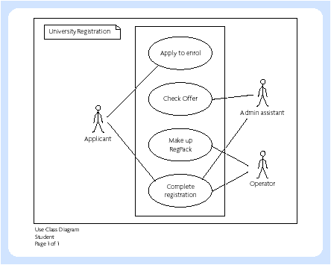
Use case diagram

Slide 10
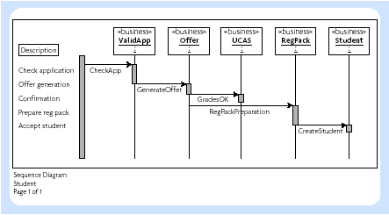
Sequence diagram

Slide 11
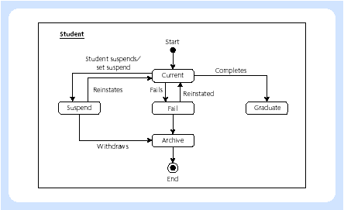
Statechart diagram

Slide 12
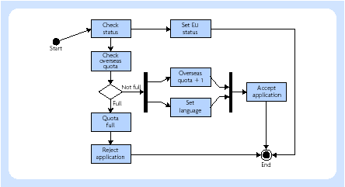
Activity diagram

